Slide 1

GURU NANAK INSTITUTIONS TECHNICAL CAMPUS
(AUTONOMOUS)
TECHNICAL SEMINAR PRESENTATION ON
NANOTECHNOLOGY
presented by
M.SAI TEJA (16WJ1A05G1)
DEPARTMENT OF COMPUTER SCIENCE AND ENGINEERING
School of Engineering and Technology
Ibrahimpatnam R.R district 501506
2019-2020

Slide 2
Abstract
Nanotechnology has potential applications in many sectors of the American economy, including consumer products, health care, transportation, energy and agriculture. In addition, nanotechnology presents new opportunities to improve how we measure, monitor, manage, and minimize contaminants in the environment.

Slide 3
Contents
Introduction
Origin of Nanotechnology
Definition of Nanotechnology
Applications
Future of Nanotechnology
Advantages and Disadvantages
Conclusion
References

Slide 4
Introduction
Nanotechnology has enormous potential to change society and it involves manipulation of objects on the automic level.
The products will be build on every atom that are stronger, smarter, cheaper, cleaner, and more precise. Nanotechnology is the art and science of manipulating matter at the nanoscale (down to 1/100,000 the width of a human hair) to create new and unique materials and products

Slide 5
Origins of Nanotechnology
Noble prize winner Richard Feynman first conceived the idea of molecular manufacturing in his 1959 speech, “There's Plenty of Room at the Bottom."
Richard Feynman was the first scientist to suggest that devices and materials could someday be fabricated to atomic specifications
In 1986, K. Eric Drexler wrote "Engines of Creation" and introduced the term nanotechnology from there Scientific research really expanded over the last decade

Slide 6
Definition of Nanotechnology
“Nanotechnology is the understanding and control of matter at dimensions of roughly 1 to 100 nanometers, where unique phenomena enable novel applications.
Encompassing nanoscale science, engineering and technology, nanotechnology involves imaging, measuring, modeling, and manipulating matter at this length scale.”

Slide 7
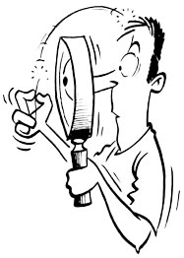

How small is nanoscale?
A nanometer is…
one billionth of a meter
DNA Sample: Approx. 2 nm
Human Hair: Approx. 1x10⁵ nm
Notes:
1. Its a bit difficult to realize how small the nano-scale is. To make things easier to get, we can say that one nanometre (nm) is one billionth of a metre.
-2. Lets see some examples to make it clear
In the picture on the right, we can see a man staring at his picked hair trying to figuring out the diameter of it, he will essentially come to the conclusion that a human hair is 100,000nm thick, while a DNA molecule is only 2 nms wide.

Slide 8
Why Nanotechnology?
At the nanoscale, the physical, chemical, and biological properties of materials differ in fundamental and valuable ways from the properties of individual atoms and molecules or bulk matter.
Nanotechnology R&D is directed toward understanding and creating improved materials, devices, and systems that exploit these new properties.

Slide 9
What is nanomaterial?
Is defined as any material that has unique or novel properties, due to the nanoscale ( nano metre- scale) structuring.
These are formed by incorporation or structuring of nanoparticles.
They are subdivided into nanocrystals, nanopowders, and nanotubes: A sequence of nanoscale of C60 atoms arranged in a long thin cylindrical structure.

Slide 10
Nanomaterials’ Characteristics
example | Category of nanomaterials
layers, multi-layers, thin films, platelets and surface coatings. They have been developed and used for decades, particularly in the electronics industry. | One-dimensional nanomaterials
nanowires, nanofibres made from a variety of elements other than carbon, nanotubes and, a subset of this group, carbon nanotubes. | Two-dimensional nanomaterials
are known as nanoparticles and include precipitates, colloids and quantum dots (tiny particles of semiconductor materials), and Nanocrystalline materials | Three-dimensional nanomaterials

Slide 11
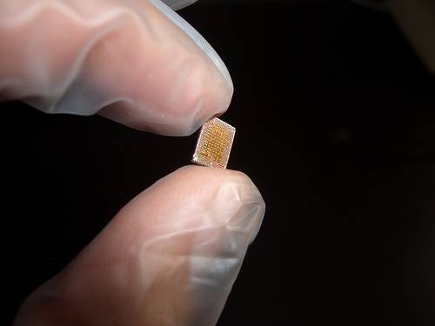
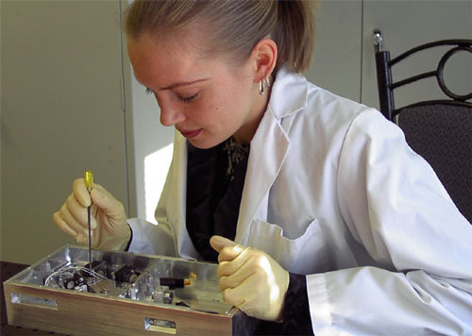
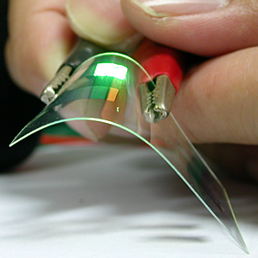
Applications of Nanotechnology
Electronics:
Nano Transistors
Nano Diodes
OLED
(Organic Light Emitting Diode)
Notes:
e.g: in da field of electronics nanotransistors are becoming more nd more popular bcoz of it’s compactness..
If u are thinking that this is a single transistor then you need to reshape your thinking, bcoz this is a transistor box containing thousonds of transistors in it…
Some other examples of nanoelectronics are Nanodiodes, OLEDs etc.

Slide 12

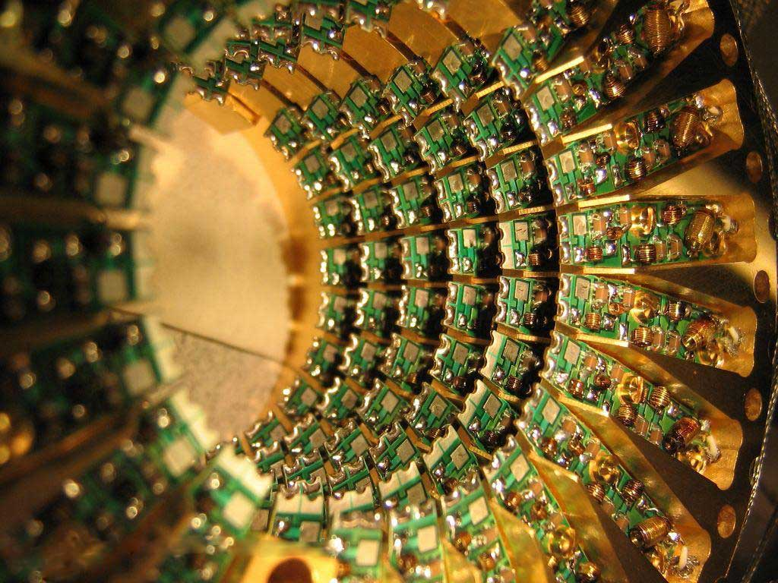
Applications of Nanotechnology
Electronics(contd.)
Plasma Displays
Quantum Computers
Notes:
The aapliances made with the help of nanoelectronics are getting its market share increasing and are becoming popular day by day due to the productivity and quality they have.
Such as plasma Displays nd Quantum computing..

Slide 13
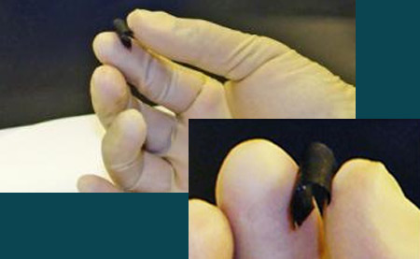
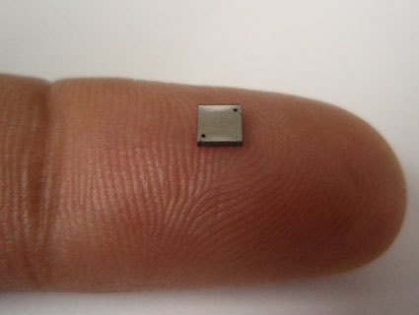
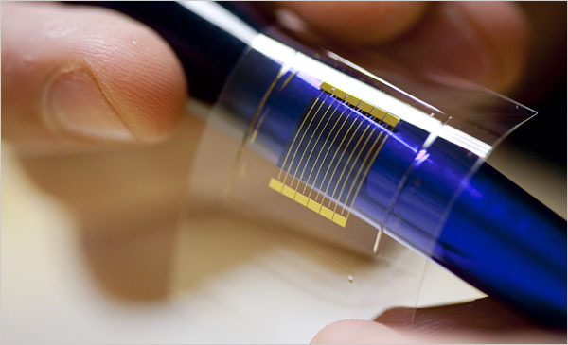
Applications of Nanotechnology
Energy:
Batteries
Fuel Cells
Solar Cells
Notes:
1-This is a nano-engineered battery, light in weight and flexible just like a paper. It can be rolled, twisted, folded or cut into a number of shapes with absolutely no loss of mechanical efficiency. Other energy suppliment examples with some change in their properties are fuel cells and solar cells

Slide 14
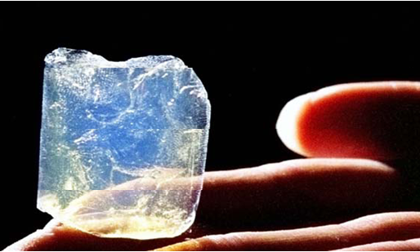
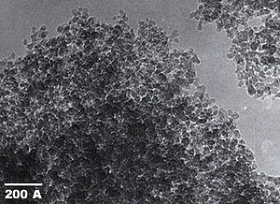
Applications of Nanotechnology
Materials:
Nano Tubes
Aerogel
Nano Particles
Notes:
1-this rotating picture is actually a model of carbon nanotube, the strongest and stiffest materials discovered till to date. These tubes are the building block of almost all the NT objects.
2- Aerogel. The world’s lightest crystalline solid
3-and nano particles

Slide 15
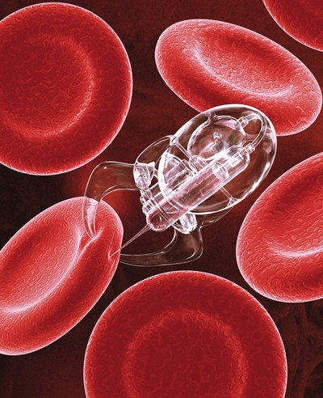
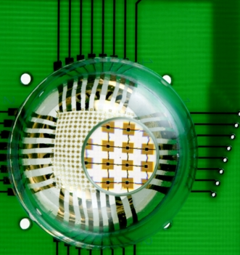
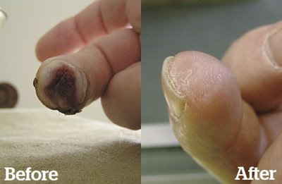
Applications of Nanotechnology
Life Sciences:
Targeted Drug Delivery
Artificial Retina
Tissue Regeneration
Notes:
Apart from the engineering and science discussed so far, NT also has its applications in medical sciences
1- this picture shows the process of Targeted drug delivery.. Which will enable mankind to diagnose nd treat all the major diseases such as cancer, HIV etc.
2-. Artificial Retina and Tissue regeneration are the other examples of NT applications in life sciences..

Slide 16
Future of Nanotechnology
Nanotechnology will redesign the future of several technologies, products and markets.
Scientists and engineers can now work with materials at the atomic level to create stain-proof fabrics, scratch-resistant paints, more efficient fuel cells and batteries
Experts says that nanotechnology will likely create the next generation of billionaires and reshape global business.

Slide 17
Govt. policy
The Government of India has made Rs. 1000 crore investments in Nanotechnology
Karnataka is planning to set up country's first nano park in Bangalore
Govt of Andhra Pradesh is planning to set up Nano-technology Park in 350 acre in Hyderabad

Slide 18
Advantages Of Nanotechnology
Medical Advantages
End of Illnesses (I.e. Cancer, heart disease)
Universal immunity (I.e. aids, flu)
Stop the aging Process
Painless Child births
Industrial Advantages
Computers a billion times faster and a million times smaller
Automatic Pollution Cleanup
Manufacturing at almost no cost

Slide 19
Advantages Of Nanotechnology
Other advantages
Architecture, Engineering and Construction industry
Materials Producers
Usage Superior Education
in Textiles Industries

Slide 20
Disadvantages Of Nanotechnology
Loss of jobs (manufacturing, farming, etc)
Oil Becomes worthless
Diamonds become worthless
Atomic weapons more accessible and destructive

Slide 21
Conclusion
Nanotechnology offers the ability to build large numbers of products that are incredibly powerful
Nanotechnology is heavily intertwined with biotechnology and information technology, making its scope very wide
The nanotechnology industry is mainly used to create new world

Slide 22

References
Morph: Nokia’s Nanotechnology Concept Phone
http://tini.us/morph
Wikipedia NT Portal
http://wikipedia.com
Image Credits
http://studymafia.org

Slide 23
Thanks…!!!!
ANY QUERIES?

